Slide 1
Employee Burnout
Cecilia Shields
July 9, 2022

Slide 2
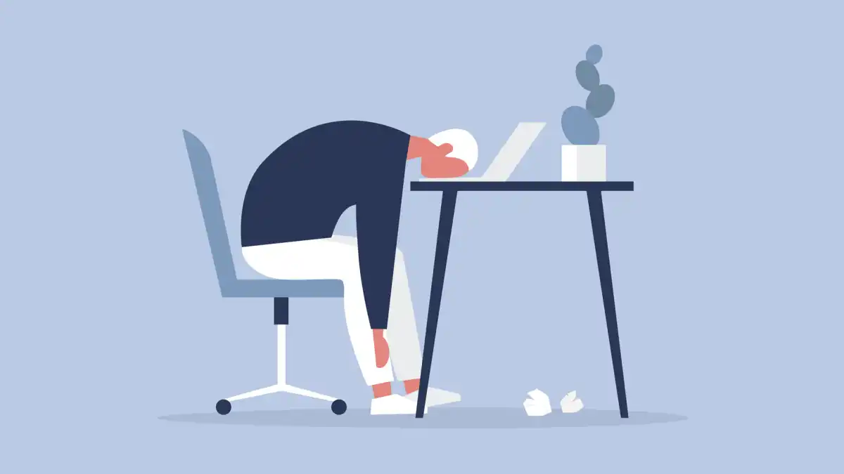
Employee Burnout is on the Rise
Employee burnout is a psychological process that occurs due to prolonged stress or excessive work hours.
A survey in 2019 showed that 23% of people felt overwhelmed and burnt out. An additional 44% felt burnt out occasionally.
Notes:
Employee burnout has become an increasingly large problem for corporations within the United States. Employees are feeling underpaid, overwhelmed, and underappreciated which is causing them to burn out faster than ever before. Pathak defines employee burnout as a psychological process that occurs due to prolonged stress or excessive work hours. A survey conducted by Stevenson in 2019 found that 23% of people felt overwhelmed and burnout in addition to 44% of people who felt burnt out occasionally. Two thirds of working individuals in the United States feel burnt out to some capacity. The employees who are feeling burned out are more likely to take more sick days, have a lower performance and look for other positions. This can be very costly for companies and can worsen the company culture and lower employee morale.

Slide 3

What Can Companies Do?
In order to prevent employees burning out, the first step is to look at an employee's demographic and stressors that could be causing them to burn out.
Employees burnout for a variety of reasons and although companies cannot avoid all employees burning out, if they know what to look for and who are at risk they may be able to help their employees before they fully burn out.
Notes:
Although some employee burnout is inevitable, there are somethings that companies can do to help stop the bleeding. Employee demographics, work duties, and work place flexibility all affect whether an employee is likely to burn out or not. A survey collected by Varshney looks at the input from hundreds of employees within the United States. This data shows a breakdown of the employees demographics, gender, job duties, among others, and their burn rate. This survey can help to show companies why their employees are burning out and can help point companies in the right direction of what to look for and what could potentially be done to keep employees from burning out.

Slide 4
The Data
Field Name | Data Type | Data Format | Field Size | Description | Example
Employee ID | Integer | NNNNNN | 24 | unique employee ID | fffe32003000360033003200
Date of Joining | Date / Time | DD/MM/YYYY | 10 | Date the employee joined the company | 11/05/2008
Gender | Varchar(6) | NNNNNN | 6 | Gender of the surveyor | Female
Company Type | Varchar(7) | NNNNNNN | 7 | Type of Company either Service or Product | Service
WFH Setup Available | Varchar(3) | NNN | 3 | Whether the employee is able to work from home or not | Yes
Designation | Numeric | # | 1 | Designation within the company, 5 meaning a high designation | 3
Resource Allocation | Numeric | # | 1 | Amount of work an employee conducts for a company, 10 meaning incredibly busy | 6
Mental Fatigue Score | Numeric | #.# | 3 | Level of mental fatigue the employee is feeling, 10 meaning complete fatigue | 3.8
Burn Rate | Numeric | #.## | 4 | Likelihood of employee burning out, 1 meaning the employee is burnt out | 0.56
Notes:
There were several hundred participants in this study that were randomly assigned an employee ID and had to answer several questions about their work situation. They had to write down their date of joining, their gender, whether they had the ability to work from home, and their company type which was either service or product. They also had to measure on a scale from one to five what their job designation was. This refers to where they fall within the corporate ladder, and five is the highest designation. The surveyors then had to on a scale from one to ten decide how busy they are at work and write down that amount in the resource allocation spot. They then had to write down on a scale from one to ten how mentally fatigued they are at work, and lastly on a scale from zero to one write out how burned out they feel.

Slide 5

Literature Review
Employer stress management intervention.
Employee stress effects their interactions with customers.
Employees want to work for ethical companies.
Notes:
There were several studies written in the last few years that looked at certain aspects of employee burnout. The first study looked at what employers can do to decrease burnout within their organization. The study, which was conducted by Gabriel and Aguinis, found that employees want stress management intervention, flexibility in how their work is conducted, better social support, more ability to make decisions, and higher quality performance management. The next study looked at the effect of employee burnout in regards to customers. The study conducted by Shoshan and Sonnentag found that employees that were experiencing emotional exhaustion caused a depersonalization which had a stronger effect on customer perception than anger and hostility which typically caused customers to retaliate with the same emotion. Another study looked at the importance of ethical leadership. The study by Mo and Shi discovered employees that have to work in unethical environments have a higher burnout rate than those who do not.

Slide 6

Research Questions
What causes an employee to burn out?
How does having the ability to work from home correlate to employee burn out?
Notes:
The first research question is what causes an employee to burn out. This is a very broad question with a number of potential answers that can be discovered by using the data. Gender, company type, work from home set up, designation within the organization, resource allocation, and mental fatigue can all cause an employee to burn out. The first question looks at what could cause an employee to burn out and what an employer should look for.
The second research question looks at the employees likely hood of burning out if they have the ability to work from home. We saw during the pandemic that a majority of employees were able to successfully work from home and the benefits of not having to commute or spend extra time out of the house. It is often viewed that employees are happier when they are able to work from home, but some companies are expressing the importance of coming into work. This question will look at whether employees are more or less likely to burn out if they do not have the opportunity to work from home.

Slide 7
What causes an employee to burnout? Hypotheses
In regards to Gender the null hypothesis (H0) states females are more likely to burnout than males.
In regards to Company Type the null hypothesis (H0) states service type companies have a higher burn rate than product type companies.
In regards to Designation allocation the null hypothesis (H0) states designation will have a negative correlation with the burn rate.
In regards to Resource Allocation the null hypothesis (H0) states resource allocation will have a positive correlation with the burn rate.
In regards to the Mental Fatigue Score the null hypothesis (H0) states the mental fatigue score will have a positive correlation with the burn rate.
Notes:
For the first research question there needed to be numerous hypotheses to fully understand the question. The first hypothesis looks at gender and states that females are more likely to burn out than males. Saad et al. states that women have been increasingly more likely to burn out than males due to keeping up with household chores and child bearing duties. The next hypothesis states that service type companies have a higher burn rate than product companies. Typically service type positions have to deal more frequently with customers that can sometimes be abrasive which could lead to a higher burnout rate. The third hypothesis states that designation will have a negative correlation with the burn rate. Although employees with a higher designation have to make the harder decisions, they have a wide range of support staff that would help bring down stress. The next hypothesis states that resource allocation has a positive correlation with burn rate. Employees that have more work to do would have a higher burn rate. The last hypothesis states that the employees mental fatigue score and burn rate will have a positive correlation. Employees that are mentally drained would be more likely to burnout. Each of these hypotheses will help answer the overall question of what causes an employee to burnout.

Slide 8

How does having the ability to work from home correlate to employee burnout? Hypothesis
The null hypothesis (H0) states employees that have a work from home set up have a lower burnout rate than employees who do not have a work from home set up.
Notes:
This research question only examines the relationship between and employee being able to work from home and their burnout rate. Melin and Egkolfogoulou conducted a study in May of 2021 and found that almost forty percent of employees would consider quitting their job if their employers did not provide flexible remote work. Ever since the Covid-19 pandemic working from home, or having the flexibility to do so has become more of the norm. People are able to have more flexible schedules and get more done around the house while still being productive at work. The null hypothesis states that employees who have the ability to work from home have a lower burnout rate than those who do not have that option. Since most employees are looking for a job with this flexibility it is likely that working from home can alleviate some stress.

Slide 9

The data being used contains quantitative data, each of the being either an integer, ordinal, or binary.
The data was collected from surveys given to workers across the United States.
Analytical Tools Used: SAS Enterprise Miner & R Studio
SAS Enterprise Miner with be used for the visual analysis
R Studio will be used to run correlation tests on several variables
Methods
Methodology
Notes:
The data being used for this research project is all quantitative data. The data is in three different forms, integer, ordinal and binary. Since each item within the data is quantitative, a variety of statistical tests can be done to better understand the data and answer the problem statement. The data was collected by Paras Varshney and his team and uploaded to Kaggle. They sent out surveys to employees all over the United States and then assigned each person an employee ID for anonymity.
Two different analytical tools will be used for the analysis of this project. SAS Enterprise Miner will be used to create visual analysis of different variables including the gender breakdown, company type analysis, whether someone is able to work from home, and so on. R Studio will be used to run correlation analysis on the burn rate and designation, resource allocation, and mental fatigue.

Slide 10

The data is completely anonymous.
The analysis will include only the data source to make sure the analysis is not tainted by other information.
Limitations
Ethical Considerations
Lack of additional data and information.
Some answers may be skewed on number scale based on an employee's opinion and their own personal bias
Notes:
With any collection of data there are always limitations. The data source that is being used has a limited number of variables which narrows down what analysis could be done. If there were additional columns like hours worked and amount of holidays in the calendar year then there could be a more complete picture. Additionally, there are several variables that are rated on a scale and these could be skewed by an employee's opinion. Two employees that have the same job and the same responsibility could rate their resource allocation differently even if it is the same. As long as the researcher is aware of the limitations, strong analysis can still be conducted. In regards to ethical considerations the data is completely anonymous. As Bhandari stated a researcher must make sure they are protecting their research participants and ensure that the research is valid and the analysis is done with integrity. The analysis conducted only uses this data source to ensure the analysis is done ethically and is not tainted by anything else.

Slide 11
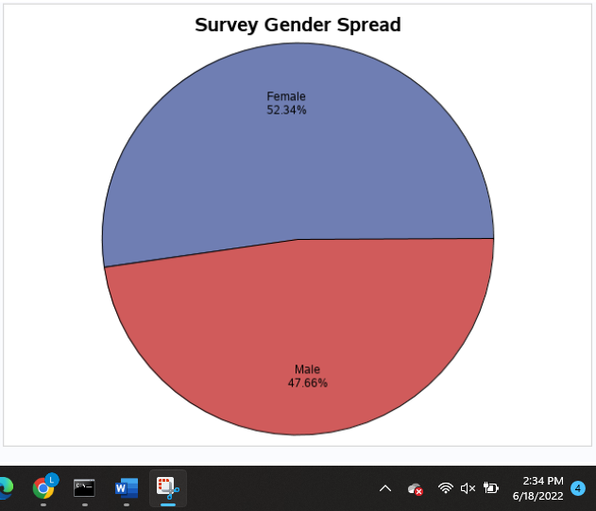
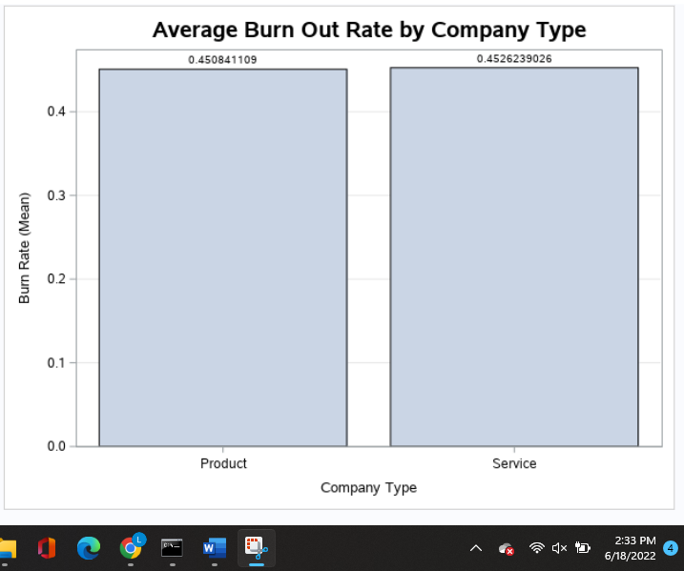
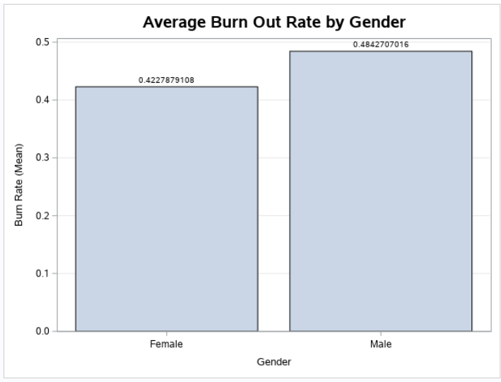
What causes an employee to burnout? Results
Notes:
After in depth analysis the hypotheses were able to be accepted or rejected. The first research question and coinciding hypotheses look at what causes an employee to burn out. The first null hypothesis states that females are more likely to burn out in males. In order to start accepting or rejecting the hypothesis it was best to start by understanding the split in data based on the gender which can be seen in the pie chart. Because the split, the hypothesis will not be skewed one way or the other based on the number of males or females. Based on market research it seemed like the hypothesis would be accepted, but as seen in Gender Bar Chart the average burn out rate for males is considerably higher than for females. The burn out rate is on a scale from zero to one and the average male burn out rate is 0.062 higher than the female burn out rate. Therefore the null hypothesis (H0) should be rejected. The next null hypothesis states that service type companies have a higher burnout rate than product type companies. Based on research and the fact that service companies tend to have to deal with customers face to face more often than product companies there should be a lower burnout rate for product companies. As seen in the bar graph the null hypothesis is correct and should be accepted. Although service companies do have an on average higher burnout rate than companies, there is only a 0.0018 difference between the two.

Slide 12
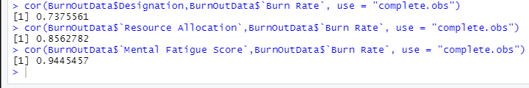
What causes an employee to burnout? Results Continued
Resource Allocation
Correlation
Designation Correlation
Mental Fatigue Correlation
0.738
0.856
0.945
Notes:
The last three hypotheses for the first business question all look at the correlation between the burn rate and three different variables within the data. The first null hypothesis states that designation will have a negative correlation. The thinking is that lower level employees will have a higher risk for burnout. The correlation is positive and quite strong with a correlation of 0.738. The null hypothesis (H0) should be rejected. The next hypothesis states that resource allocation will have a positive correlation with burn rate. Employees that are given more work will have a higher burn rate. The correlation is positive and strong with a correlation of 0.856. The null hypothesis (H0) is accepted. The last hypothesis for the first research question is the mental fatigue score will have a positive correlation with the burn rate. Research shows that individuals with more mental fatigue are more likely to stop caring about their job and burnout faster than those who do not. There is a strong and positive correlation of 0.945 between the two. The null hypothesis (H0) should be accepted. Each of these hypotheses helped to answer the research question as to what could be the cause of employee burnout.

Slide 13
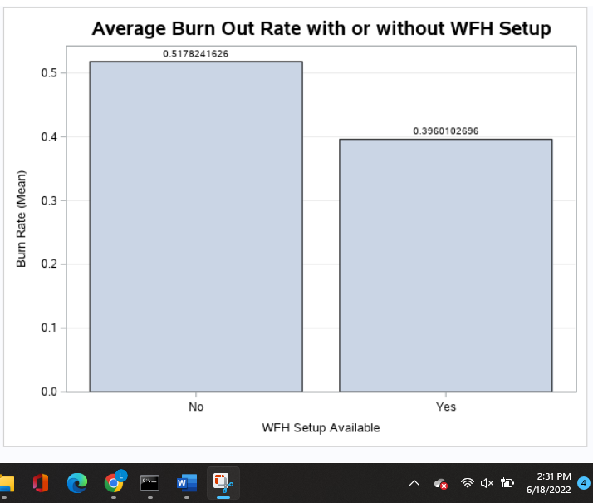
How does having the ability to work from home correlate to employee burnout? Results
Notes:
The second research question looks at whether having the ability to work from home decreases employee burnout. Since the pandemic started people have been working from home more frequently and studies have shown that more and more people would rather find another job than return to work in the office full time. The null hypothesis (H0) states employees that have work from home set up available to them have a lower burn rate than employees who do not. The bar graph shows the average burnout rate for employees that are able to work from home versus those who do not have that option. Employees that are able to work from home have an average 0.121 lower burnout rate than those who are not able to work from home. The null hypothesis should be accepted.

Slide 14

Recommendation & Conclusion
This analysis gives companies a general understanding of what they need to watch for within their employees and what adjustments they may be able to make to keep their employees from burning out.
Going forward it may be good to look at some of the additional factors and see how much they attribute to the burnout rate. In addition, companies may want to look at what they can do within their organization to help deter employee burnout.
Notes:
Employees are more likely to quit now if they are not satisfied with their company than ever before. The data used for this study gathers information from employees all over the United States to figure out what may relate to an employee's burn out rate. The analysis conducted found that men and those who work in the service industry are more likely to burn out. An employee designation, resource allocation, and mental fatigue all positively correlate with their burnout rate. Additionally, employees that have the option to work from home are less likely to burnout than those who do not. In the future it may be good to look at some of the additional factors that may contribute to burn out rate including commute time and number of holidays, among others. Companies may want to look at what they can do within their organization to help deter employee burnout. Although helping with the factors discussed can be beneficial it may also be helpful to introduce destress rooms, mandatory breaks, coffee and donut Fridays, and so on. These additional benefits can help balance some of the additional stresses that come along with a job. The research and analysis conducted is a great starting point, but it does not provide all of the answers as to why an employee may be experiencing burnout.

Slide 15
References
Gabriel, K. P., & Aguinis, H. (2022). How to prevent and combat employee burnout and create healthier workplaces during crises and beyond. Business Horizons, 65(2), 183–192. https://doi.org/10.1016/j.bushor.2021.02.037
Melin, A., & Egkolfopoulou, M. (2021, June 1). Employees are quitting instead of giving up working from home. Bloomberg.com. Retrieved June 7, 2022, from https://www.bloomberg.com/news/articles/2021-06-01/return-to-office-employees-are-quitting-instead-of-giving-up-work-from-home
Mo, S., & Shi, J. (2017). Linking Ethical Leadership to Employee Burnout, Workplace Deviance and Performance: Testing the Mediating Roles of Trust in Leader and Surface Acting. Journal of Business Ethics, 144(2), 293–303. https://doi.org/10.1007/s10551-015-2821-z
Pathak, A. (2021, December 27). Employee burnout: understanding and tackling it. Nurture an Engaged and Satisfied Workforce | Vantage Circle HR Blog. Retrieved June 8, 2022, from https://blog.vantagecircle.com/employee-burnout/
Shields, C., (2022). BurnOutData. (n.d.). R Studio.
Shields, C., (2022). BurnOutData. (n.d.). SAS Enterprise Miner.
Shoshan, H., & Sonnentag, S. (2020). The effects of employee burnout on customers: An experimental approach. Work & Stress, 34(2), 127–147. https://doi.org/10.1080/02678373.2019.1577312
Stevenson, M. (2020, January 17). Employee burnout statistics you need to know. HR Exchange Network. Retrieved June 6, 2022, from https://www.hrexchangenetwork.com/employee-engagement/news/employee-burnout-statistics-you-need-to-know
Varshney, P. (2021). Are your employees burning out? [Data File]. Retrieved from https://www.kaggle.com/datasets/blurredmachine/are-your-employees-burning-out

